Slide 1



Culture setting and promoting staff ‘attributes’

Slide 2



What I would like us to look at
I want an interactive discussion around using a ‘ staff attributes framework’ to establish staff culture
Why?
Our experience has been that staff can be both
or
Your greatest asset
Your worst nightmare
We wanted a framework to better establish expectations in terms of their attitude and behaviour

Slide 3


The issue we faced
There has been some good work done around profiling staff ‘values’ to aid in their recruitment and selection, most notably Profiling Values which assesses as to whether staff would be better in a caring or supporting role.
What we wanted to develop however was more around setting expectations in terms of what we did and did not want to see in relation to staff’s attitudes and behaviours.
This is an exercise that you can do within your own service. The advantages of this are:
It helps you establish your own culture
It helps promote staff’s ownership of this
I’d encourage you to have your own conversations.

Slide 4


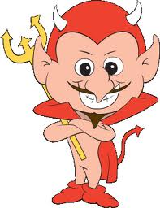

What we did
In terms of what we did …
We had conversations with the people we supported and our staff to find out what they valued about their staff and colleagues and what the things were that they didn’t like.
We wanted to establish both what people felt to be positive staff behaviours or attributes and also the behaviours that people felt were unacceptable.

Slide 5

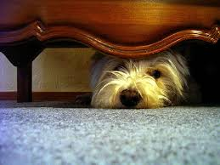




What we found
The behaviours and attributes our service users wanted to see in their staff
Polite and respectful
They appreciated feeling safe
Friendly and kind
Understanding
Responsive
Genuinely helpful and supportive

Slide 6


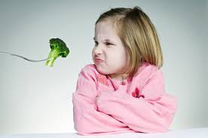



What we found
The behaviours and attributes our service users did not want to see
Rudeness
Shouting or being angry / aggressive
Doing things they don’t want
Moaning and not wanting to be at work
Ignoring them or not listening
Not coming when they needed them

Slide 7








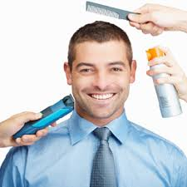

What we found
The behaviours and attributes staff members wanted to see in their colleagues
Friendly and approachable
That they wanted to be at work
Reliable and dependable
Conscientious and got things done
Cooperative
Proactive and show initiative
Calm and level headed
Respectful
Presentable
Adaptable and flexible

Slide 8
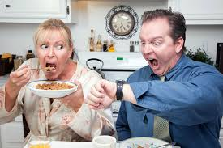



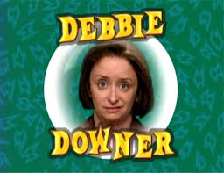
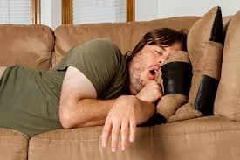



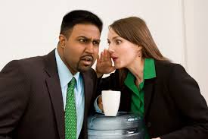
What we found
The behaviours and attributes staff didn’t want to see in their colleagues
Poor timekeeping
Always moaning
Arrogance
Being insensitive to the needs of others
Negative attitude
Laziness
Being inappropriate
Putting people down / belittling them
Gossiping
Disinterested in work

Slide 9









What we found
The behaviours and attributes we wanted to see in our staff
To respect people’s privacy and the confidentiality of their information
To practice safely
Reliable and dependable
To act responsibly
Honest and trustworthy
To communicate effectively
To promote quality
To take responsibility for their learning
To show common sense
Conscientious

Slide 10





What we found
The behaviours and attributes we didn’t want to see in our staff
Disrespectful or discriminatory behaviour
Not being a team player
Blaming others and not taking responsibility
Refusing to cooperate / being wilfully obstructive
Dishonesty

Slide 11
So what did we do about it?
First of all we developed a staff attributes framework which clearly lays out the attitudes and behaviours we expect and don’t want to be seeing
Within this we were explicit about the nature of the disciplinary offence that a person might be subject to if they exhibited any of the unwanted attitudes or behaviours.
In relation to the people we support
Rudeness
= Serious misconduct
Shouting or being angry / aggressive
Potentially gross misconduct
Neglecting people - Not coming when they are needed
Potentially gross misconduct
Ignoring people and not listening to them
Potentially gross misconduct

Slide 12
So what did we do about it?
In relation to the people we support
Doing things they don’t want
= Serious misconduct / potentially gross misconduct
Moaning and not wanting to be at work
= Misconduct / serious misconduct

Slide 13
So what did we do about it?
In relation to their colleagues
Poor timekeeping
= Misconduct / serious misconduct
Negative attitude
= Misconduct
Always moaning
= Misconduct
Gossiping
= Misconduct / serious misconduct
Laziness
= Misconduct
Disinterested in work
= Misconduct (potentially serious misconduct if addressed and it continues)

Slide 14
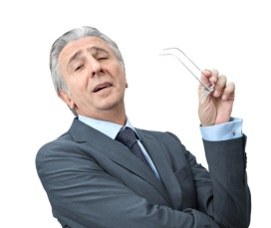

So what did we do about it?
In relation to their colleagues cont’d
Arrogance
Depends on how it impacts - likely to be misconduct
Being insensitive to the needs of others
Depends on how it impacts - likely to be misconduct
Putting people down / belittling them
= Misconduct (potentially serious misconduct if addressed and it continues)
Being inappropriate
= Serious misconduct / potentially gross misconduct

Slide 15

So what did we do about it?
In relation to the Company
Disrespectful or discriminatory behaviour
= Potentially gross misconduct
Blaming others and not taking responsibility
= Misconduct / serious misconduct
Not being a team player
= Misconduct
Refusing to cooperate / being wilfully obstructive
= Serious misconduct (potentially gross misconduct)
Dishonesty
= Gross misconduct

Slide 16
So what did we do about it?
We use both our Staff Attributes Framework and our Employee’s Handbook to be up front with staff around what constitutes different types of misconduct
The Employee’s Handbook also outlines the sanctions that are likely to be imposed if a person is found to have exhibited a form of misconduct through our disciplinary policy.
Offence | 1st occasion | 2nd occasion | 3rd occasion | 4th occasion
Unsatisfactory Conduct | Improvement notice | Written warning | Final written warning | Dismissal
Misconduct | Written warning | Final written warning | Dismissal
Serious misconduct | Final written warning | Dismissal
Gross misconduct | Dismissal

Slide 17




So what did we do about it?
It is not all about sanctions, this is about developing a positive working culture. The emphasis is on encouraging staff to understand how it is that we want them to be working and why this is.
In order to do this we:
Amended our Person Specification to reflect the attitudes and behaviours we wanted to see so that staff are provided with this information at the outset
Go through the Staff Attributes Framework with staff as part of their induction. This currently fits within the ‘Understanding your Role’ (Standard 1) of the Care Certificate.
Go through the Staff Attributes Framework with staff as part of their initial supervision session along with the Supervision Agreement and Confidentiality Statement. Also as part of their probationary period review.
Recently introduced it as part of a 360 degree appraisal process where service user, colleagues and the line manager are asked to provide feedback in relation to the staff attributes.

Slide 18
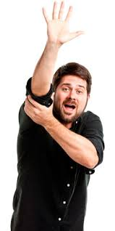

Any further questions?
Thank you for listening
Mik Alban
Phoenix Resolutions
Mobile: 07788 498909
Email: mik.alban@careandsupportwest.co.uk

